Slide 1


Etienne De Vlieger
11 April 2022

Slide 2

Outline
Executive Summary
Introduction
Methodology
Results
Conclusion
Appendix

Slide 3
Executive Summary
Summary of methodologies
Data collection
Data wrangling
EDA with data visualization
EDA with SQL
Interactive map with Folium
Dashboard with Plotly Dash
Predictive analysis by classification model
Summary of all results
EDA results
Interactive analytics
Predictive analysis

Slide 4
Introduction
Project background and context
SpaceX advertises Falcon 9 rocket launches on its website with a cost of 62 million dollars. Other providers cost upwards of 165 million dollars each, much of the savings is because SpaceX can reuse the first stage.
Problems to find answers
The question is: is the first stage of the SpaceX Falcon 9 will land successfully ?

Slide 5

Section 1

Slide 6
Methodology
Executive Summary
Data collection methodology:
2 data sources:
SpaceX Rest API
Web Scraping from Wikipedia
Perform data wrangling
Discovering data by value counts
Identify the categorical/numerical columns. Replacing NULL values
Select relevant columns and label for classification
Perform exploratory data analysis (EDA) using visualization and SQL
Perform interactive visual analytics using Folium and Plotly Dash
Perform predictive analysis using classification models
How to build, tune, evaluate classification models

Slide 7
Methodology
Executive Summary(continued)
Perform predictive analysis using classification models
Best parameters for Linear Regression, K-nearest neighborhood, Supervised Vector Machine, Decision Tree models
Comparing the scores

Slide 8
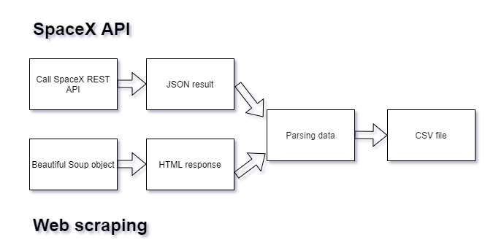
Data Collection
2 data sources:
SpaceX Rest API
https://api.spacexdata.com/v4/entry point
Web scraping from Wikipedia
Falcon 9 launch data
 | entry point
Data for | rockets
Data for | launchpads
 | payloads
 | cores

Slide 9
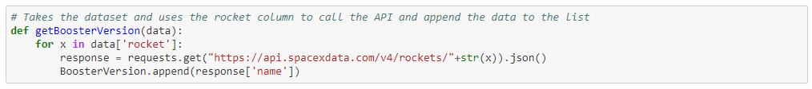
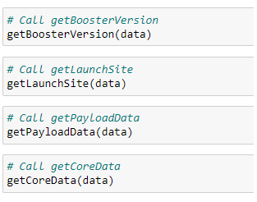
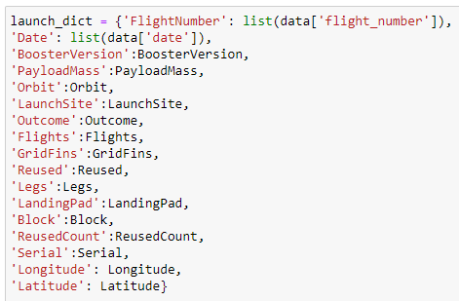
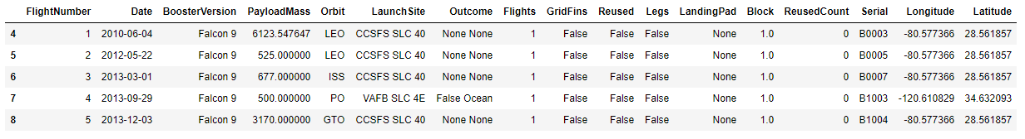
Data Collection – SpaceX API
1. Example of API helper function
2. Call list 3. Dictionary
4. Result to export to a .CSV file
GitHub URL
https://github.com/devliet/SpaceX_project/blob/master/SpaceX%20data%20collection.ipynb

Slide 10
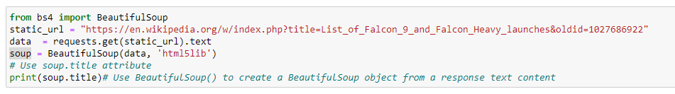
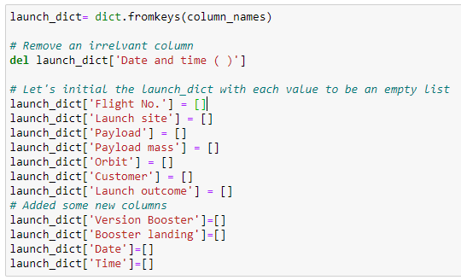
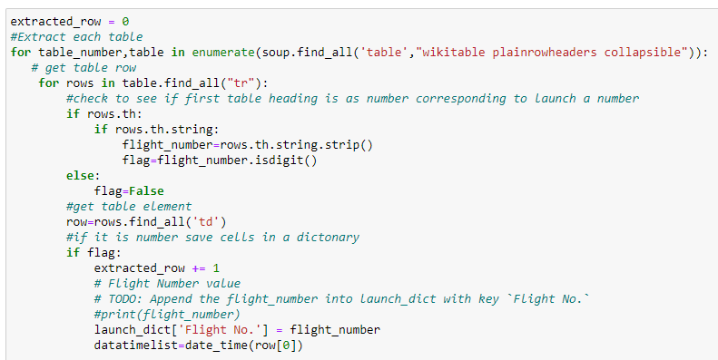
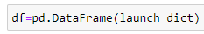
Data Collection - Scraping
1. Creating BeautifulSoup object
2. Target dataframe
3. Loop over HTML extract functions
4. Dataframe ready for CSV file
GitHub URL
https://github.com/devliet/SpaceX_project/blob/master/jupyter-labs-webscraping%20(1).ipynb

Slide 11
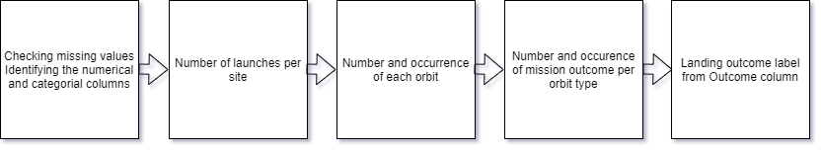
Data Wrangling
Find patterns and label for supervised models
Data analysis
number of launches for each site
mission outcome per orbit type
Landing outcome label from Outcome column
GitHub URL
https://github.com/devliet/SpaceX_project/blob/master/EDA.ipynb

Slide 12
EDA with Data Visualization
Charts plotted:
Scatter plot for discovering relationships between categories
Bar plot for checking quantities as mean
Line chart to examine a trend
GitHub URL
https://github.com/devliet/SpaceX_project/blob/master/EDA%20with%20Visualization%20lab.ipynb

Slide 13
EDA with SQL
SQL queries summary
Display the names of the unique launch sites in the space mission
Display 5 records where launch sites begin with the string 'CCA’
Display the total payload mass carried by boosters launched by NASA (CRS)
Display average payload mass carried by booster version F9 v1.1
List the date when the first successful landing outcome in ground pad was achieved
List the names of the boosters which have success in drone ship and have payload mass greater than 4000 but less than 6000
List the total number of successful and failure mission outcomes
List the names of the booster versions which have carried the maximum payload mass
List the failed landing outcomes in drone ship, their booster versions, and launch site names for in year 2015
Rank the count of landing outcomes (such as Failure (drone ship) or Success (ground pad)) between the date 2010-06-04 and 2017-03-20, in descending order
GitHub URL
https://github.com/devliet/SpaceX_project/blob/master/EDA%20SQL%20Lab.ipynb

Slide 14
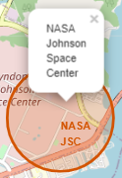
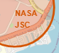
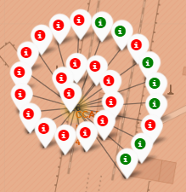
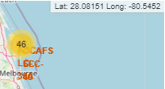
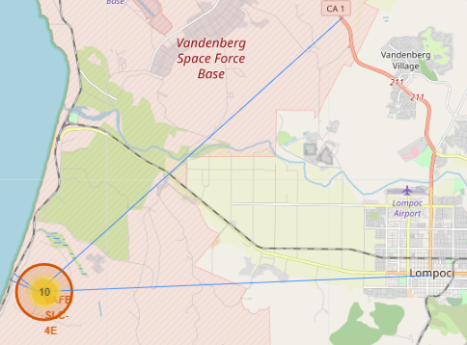
Build an Interactive Map with Folium
The plain numbers don’t give any intuitive insights about where are those launch sites. It’s better to visualize those locations by pinning them on a map
Folium map objects:
Circle | Marker | MarkerCluster | MousePosition | PolyLine
To have a highlighted circle area with a text label on each launch site | To check if the launch site has a proximity with Equator line or a coast | To distinguish Markers having the same coordinate | To have the coordinates of a site and calculate distances | To display the distance between a site and the coast, city, etc.
GitHub URL
https://github.com/devliet/SpaceX_project/blob/master/Interactive%20Visual%20Analytics%20with%20Folium%20lab.ipynb

Slide 15
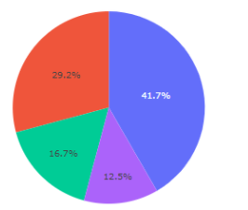
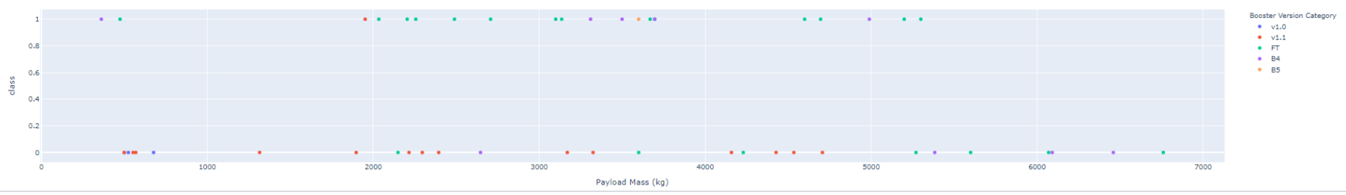
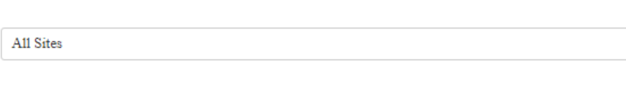
Build a Dashboard with Plotly Dash
Plots/graphs
Pi chart | To check the site with largest successful launches
Scatter plot | To check which payload range(s) has the highest launch success rate
Dropdown list | For selecting the list of launch sites | Interaction with Pi chart for displaying data accordingly to the selected site
Range slider | For selecting Payload range (Kg) | Interaction with scatter plot for displaying the data accordingly to the range of Payload range (Kg)
GitHub URL
https://github.com/devliet/SpaceX_project/blob/master/spacex_dash_app.py.ipynb

Slide 16
Predictive Analysis (Classification)
Machine learning pipeline to predict if the first stage will land given the data from the preceding labs
Column for the label to predict
Standardize the data
Split into training data and test data
Find best hyperparameters for SVM, Classification Trees and Logistic Regression
Find the method performs best using test data
GitHub URL
https://github.com/devliet/SpaceX_project/blob/master/SpaceX_Machine%20Learning%20Prediction_Part_5.ipynb

Slide 17

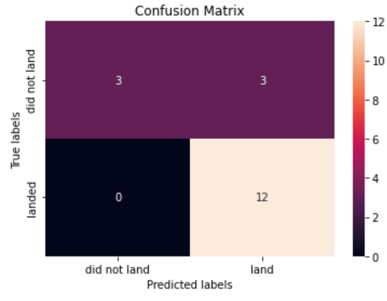
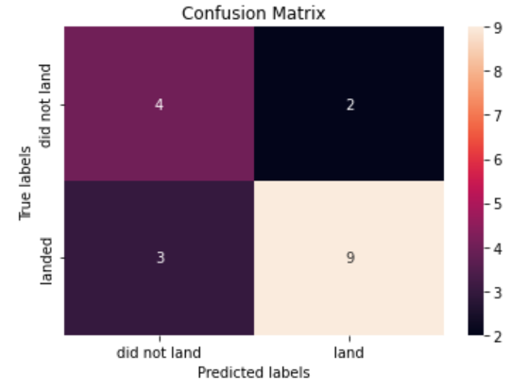

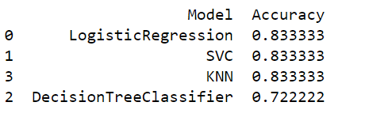
Results
Exploratory data analysis results using the confusion matrix; the results are very similar between the models except for the Decision Tree model
LogisticRegression
SVM
DecisionTree
KNN
Predictive analysis results based on the score of each model

Slide 18

Section 2

Slide 19
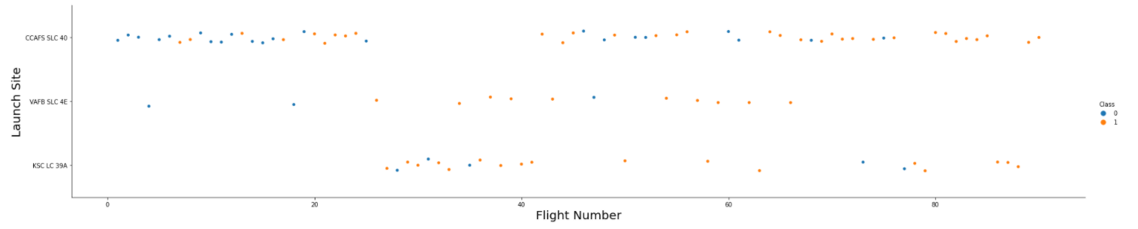
Flight Number vs. Launch Site
More and more success launchs with more charge
CCFAFS SLC 40 is the most frequently used launch site

Slide 20
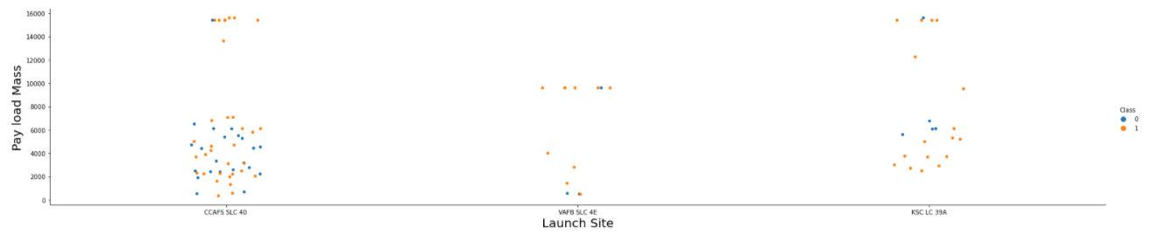
Payload vs. Launch Site
No rockets launched for heavy payload mass(greater than 10000)
CCAFS LC-40, has a success rate of 60 %, while KSC LC-39A and VAFB SLC 4E has a success rate of 77%

Slide 21
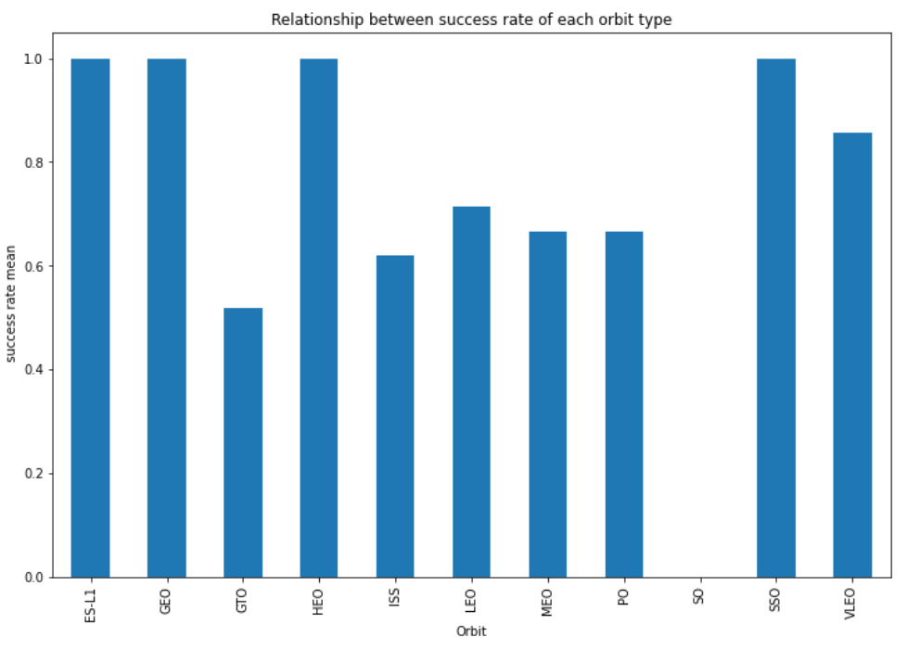
Success Rate vs. Orbit Type
The ES-L1, HEO and SSO have the best success rate

Slide 22
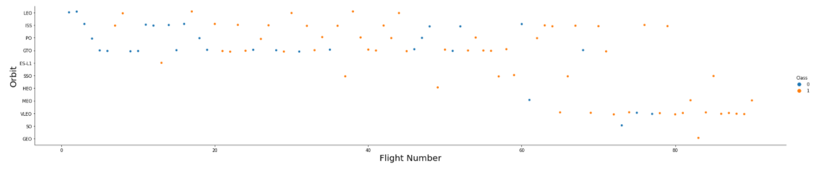
Flight Number vs. Orbit Type
In the LEO orbit the success appears related to the number of flights
A lot of flight number failed in GTO orbit

Slide 23
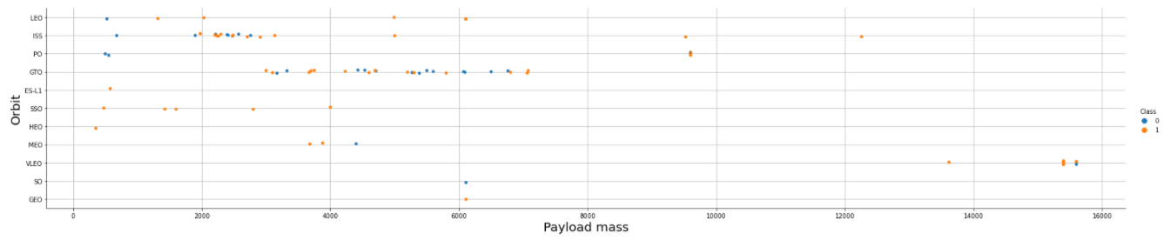
Payload vs. Orbit Type
With heavy payloads the successful landing or positive landing rate are more for Polar, LEO and ISS

Slide 24
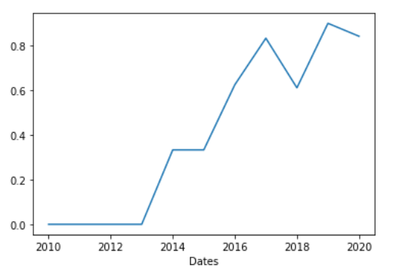
Launch Success Yearly Trend
The success rate since 2013 is increasing till 2020

Slide 25
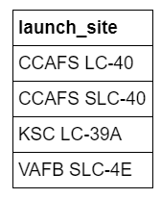
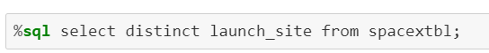
All Launch Site Names
Names of the unique launch sites
Get the distinct values of the field ‘launch_site’

Slide 26
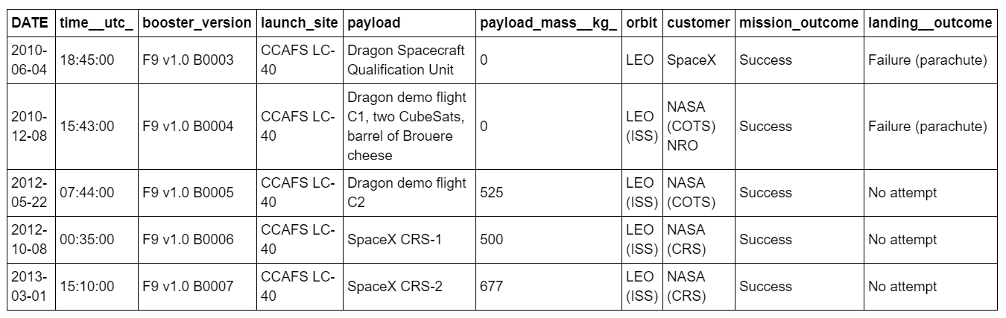
Launch Site Names Begin with 'CCA'
5 records where launch sites begin with `CCA`
Get 5 launch sites beginning with `CCA`

Slide 27
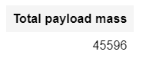
Total Payload Mass
Total payload carried by boosters from NASA
Select the total of payload mass where customer = ‘NAS (CRS)’

Slide 28
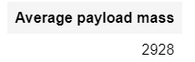
Average Payload Mass by F9 v1.1
Average payload mass carried by booster version F9 v1.1
Average of payload mass field where ‘booster_version’ field starting with ‘F9 v1.1’

Slide 29
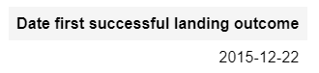
First Successful Ground Landing Date
Dates of the first successful landing outcome on ground pad
First date where landing_outcome is a success

Slide 30
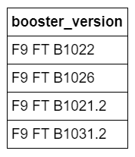
Successful Drone Ship Landing with Payload between 4000 and 6000
Names of boosters which have successfully landed on drone ship and had payload mass greater than 4000 but less than 6000
Selection of booster version where landing outcome = ‘Success’ and pay load mass > 4000 and < 6000

Slide 31
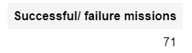
Total Number of Successful and Failure Mission Outcomes
Total number of successful and failure mission outcomes
Count of failures and success missions

Slide 32
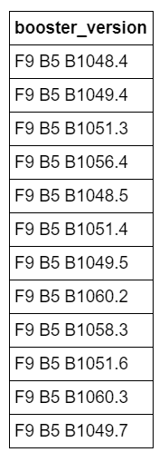
Boosters Carried Maximum Payload
Names of the booster which have carried the maximum payload mass
Get booster version having a max pay load mass kg

Slide 33
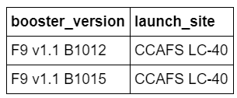
2015 Launch Records
List of failed landing_outcomes in drone ship, their booster versions, and launch site names for in year 2015
Get booster versions where there is a drone failure and the date = 1975

Slide 34
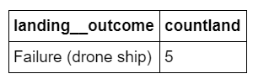
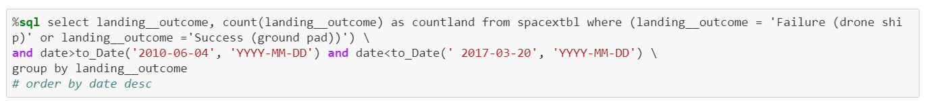
Rank Landing Outcomes Between 2010-06-04 and 2017-03-20
Rank the count of landing outcomes (such as Failure (drone ship) or Success (ground pad)) between the date 2010-06-04 and 2017-03-20, in descending order
Select the count of landing outcomes (such as Failure (drone ship) or Success (ground pad)) between 2010-06-04 and 2017-03-20, in descending order

Slide 35

Section 3

Slide 36
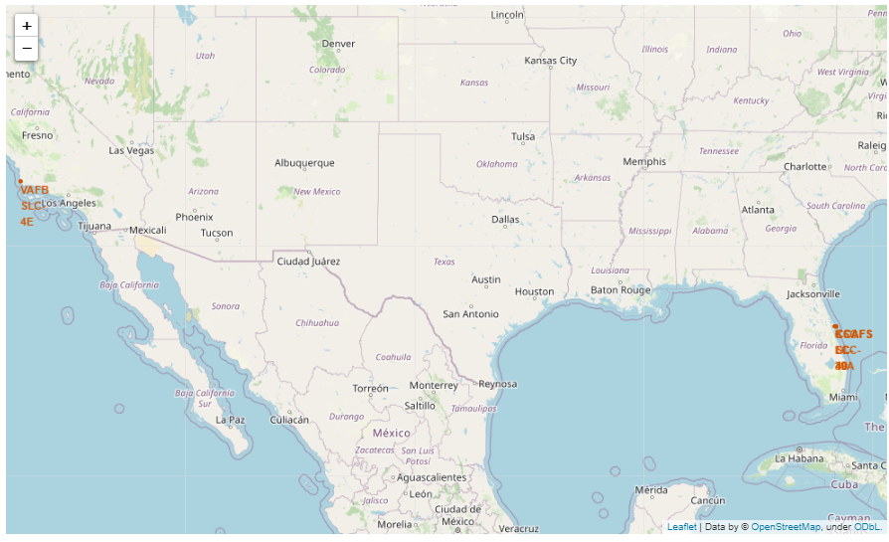
Launch sites on the map
Every launch site is near the coast

Slide 37
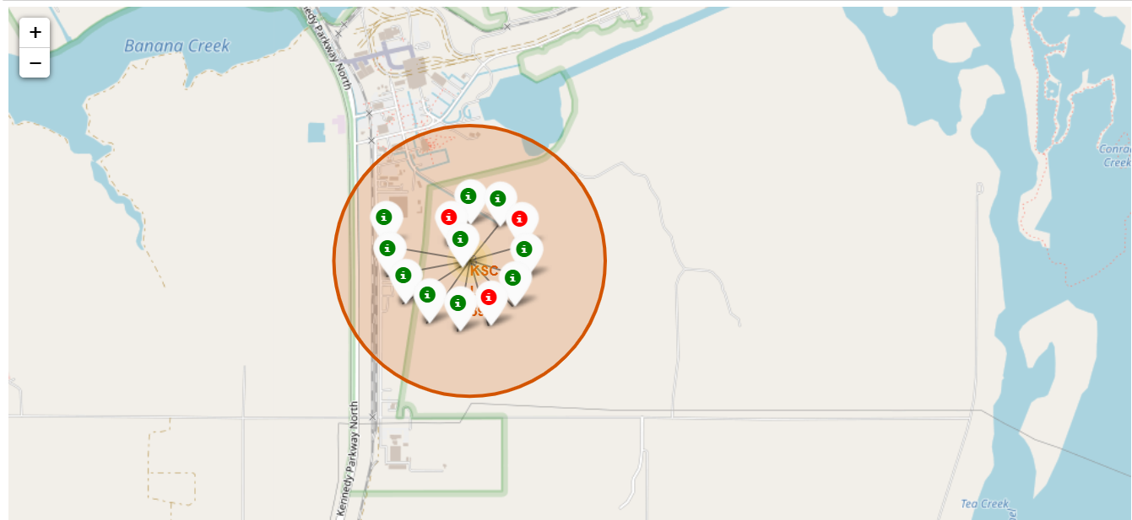
Color-labeled launch site
Marker cluster displaying the outcomes

Slide 38
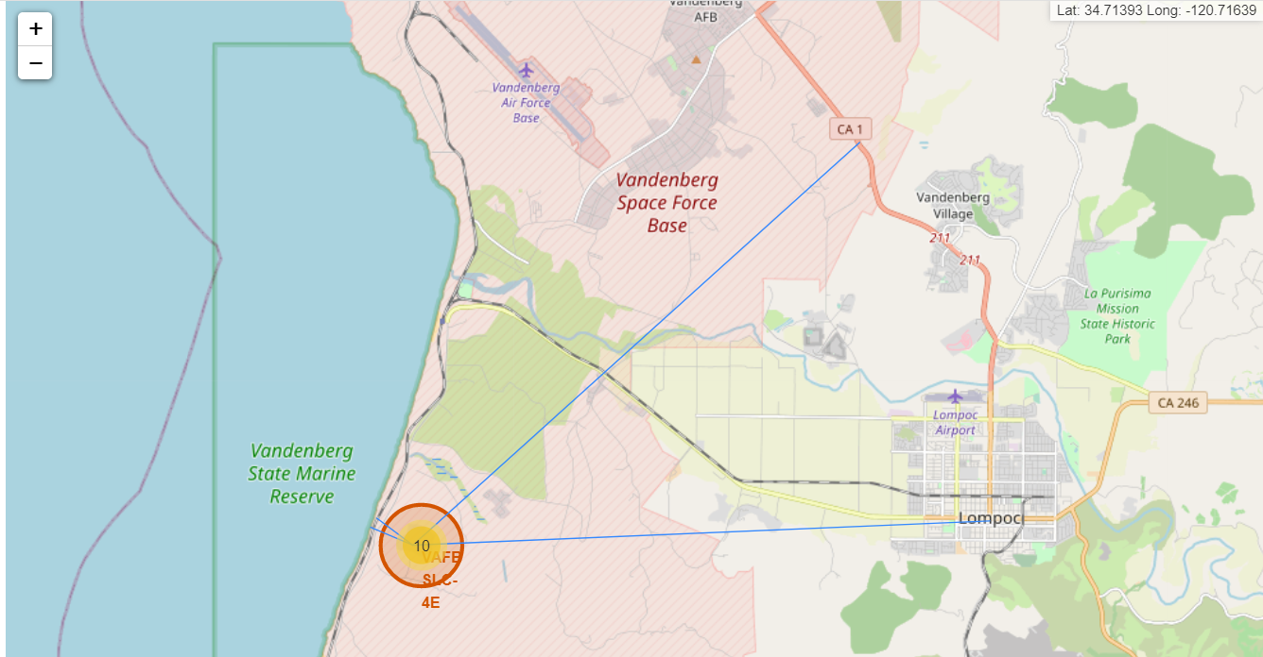
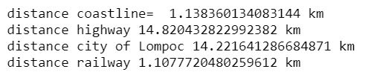
Selected launch site to its proximities

Slide 39

Section 4

Slide 40
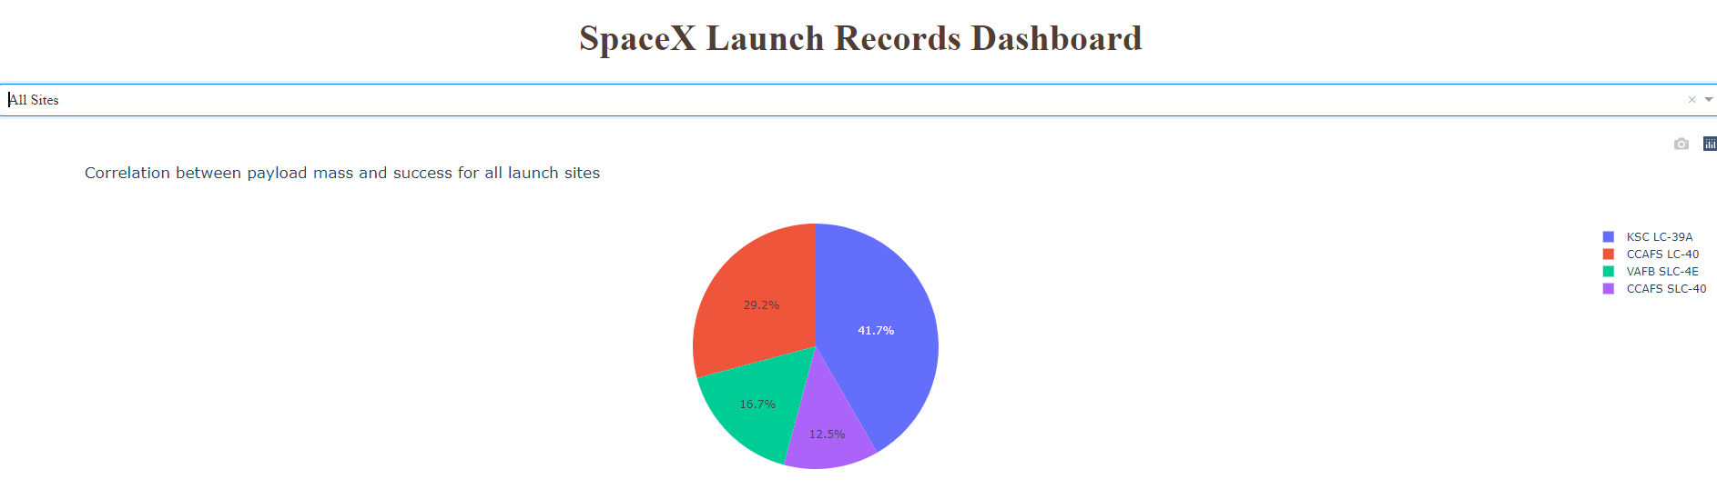
Dashboard of launch success count for all sites
Pie chart of launch success count for all sites
CCAFS LC-40 has the most success launches

Slide 41
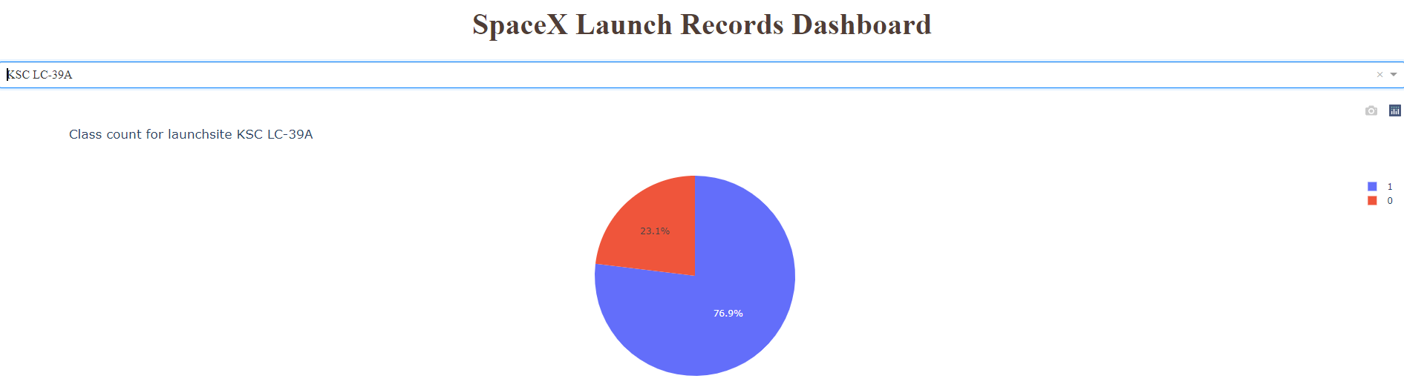
Dashboard for the launch site with highest launch success ratio
Piechart for the launch site with highest launch success ratio
The launch site ‘KSC LC-39A’ hs the highest launch success ratio

Slide 42
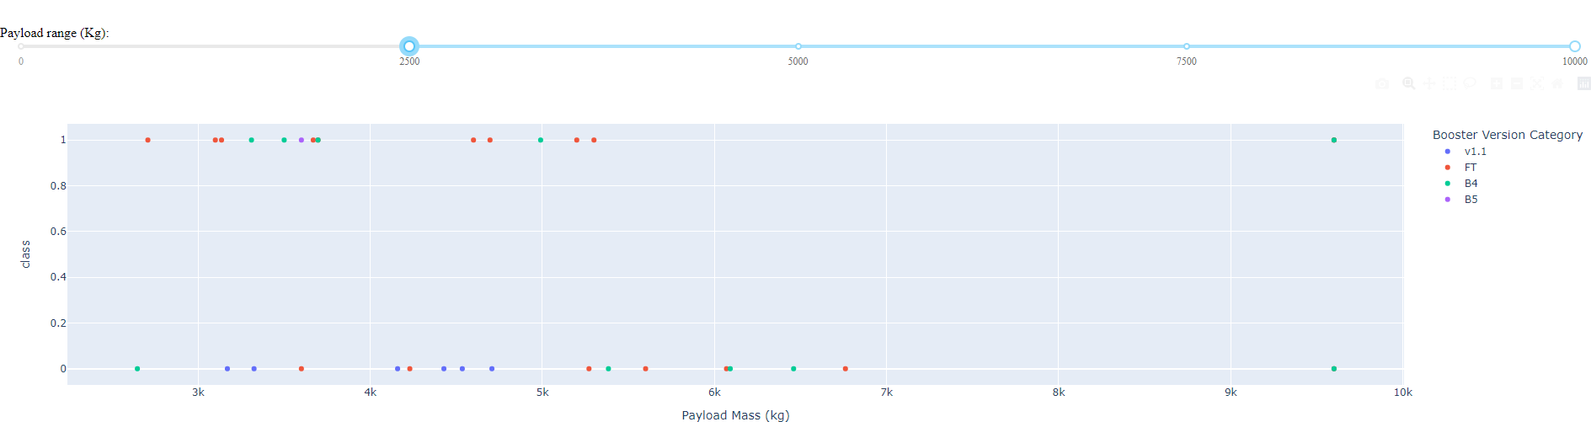
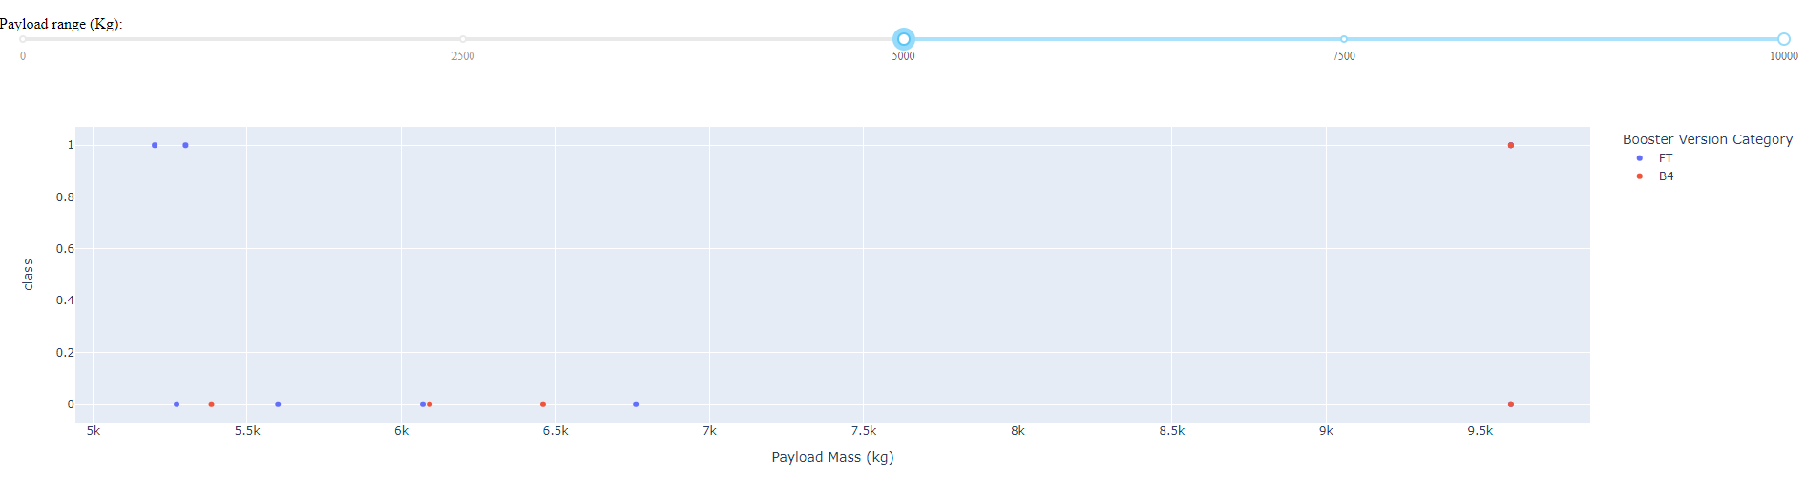
Payload vs. Launch Outcome scatter plot for all sites

Slide 43
Payload vs. Launch Outcome scatter plot for all sites(continued)
Site with the largest successful launches: KSC LC-39A
Site with the highest launch success rate: KSC LC-39A
Payload rang(s) with the highest launch success rate: 1952 to 5300
payload range(s) with the lowest launch success rate: from 4159, the success rate declined
F9 Booster version (v1.0, v1.1, FT, B4, B5, etc.) with the highest launch success rate: FT

Slide 44

Section 5

Slide 45
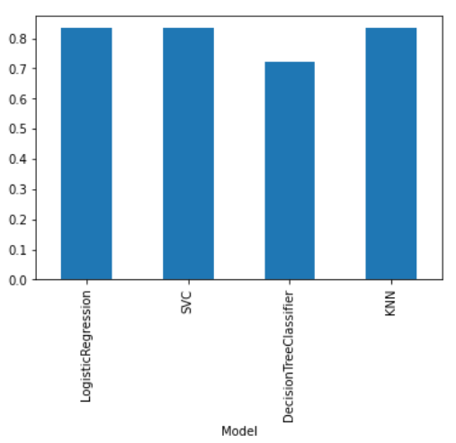
Classification Accuracy
The Decision Tree performs less than the others. The test data must be enlarged to make more distinguable the models.

Slide 46
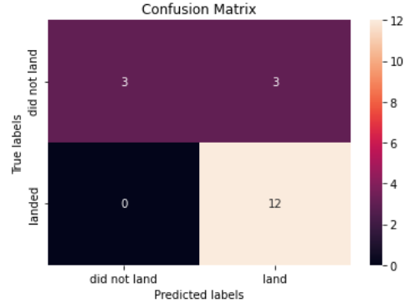
Confusion matrix of the best performing model
Three models have the same score above except the decision tree model
3 type II errors occured

Slide 47
Conclusions
The best models are the logistic regression, SVM and KNN
The launch site ‘KSC LC-39A’ has the highest launch success ratio
The success of the launch sites increase along the time
The heavy payloads(>10000) have too much failure outcomes and can be a risk factor

Slide 48
Appendix
All the Jupyter notebooks shared and available on GitHub. Please refer to the url when available below the slide
Python code, SQL queries, charts and outputs are available in the Jupyter notebook
The needed data sets are first downloaded when running a Jupyter notebook

Slide 49


